Slide 1
ABI-Stable Node
Node.js API (n-API)

Slide 2
Things to cover
Progress update
Usability
API Coverage
Demo
Performance
Remaining Work
Proposal and Discussion
Next steps

Slide 3
Goals
Create ABI stable API surface for Node.js native modules
Ensure other Node-VMs can implement these API

Slide 4
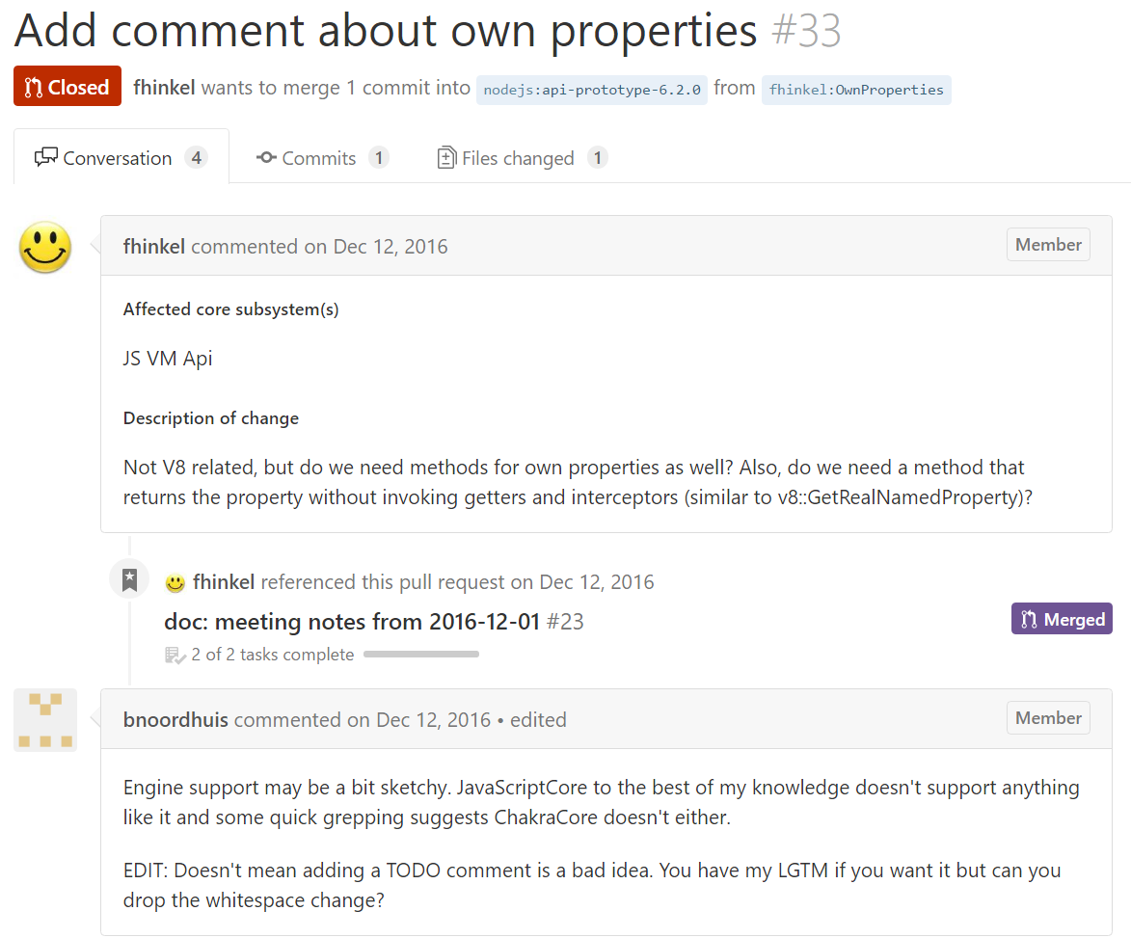
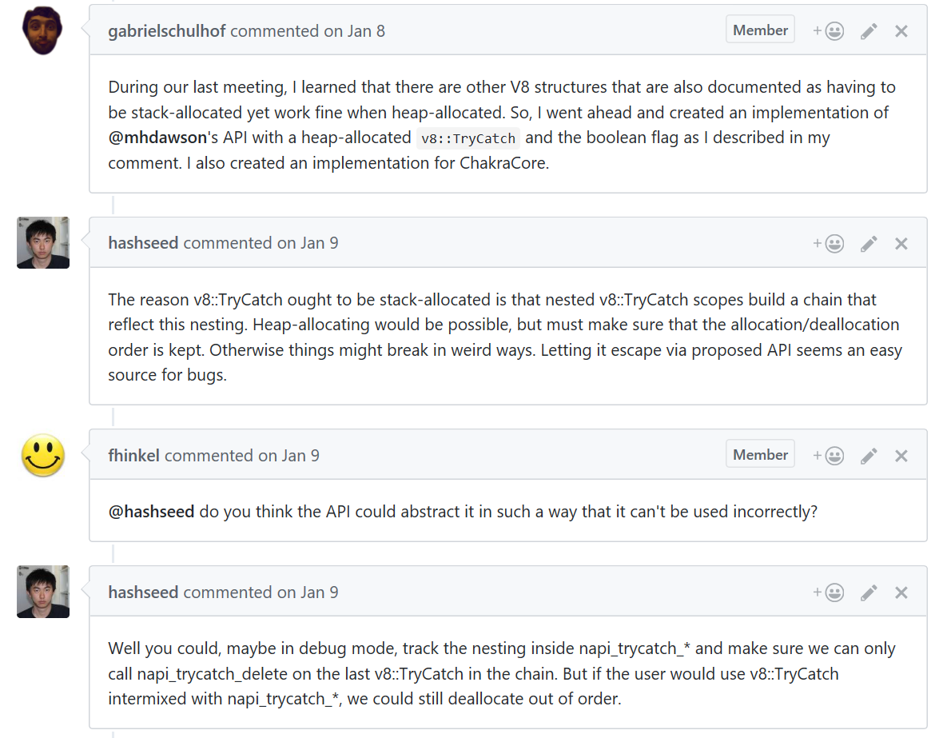







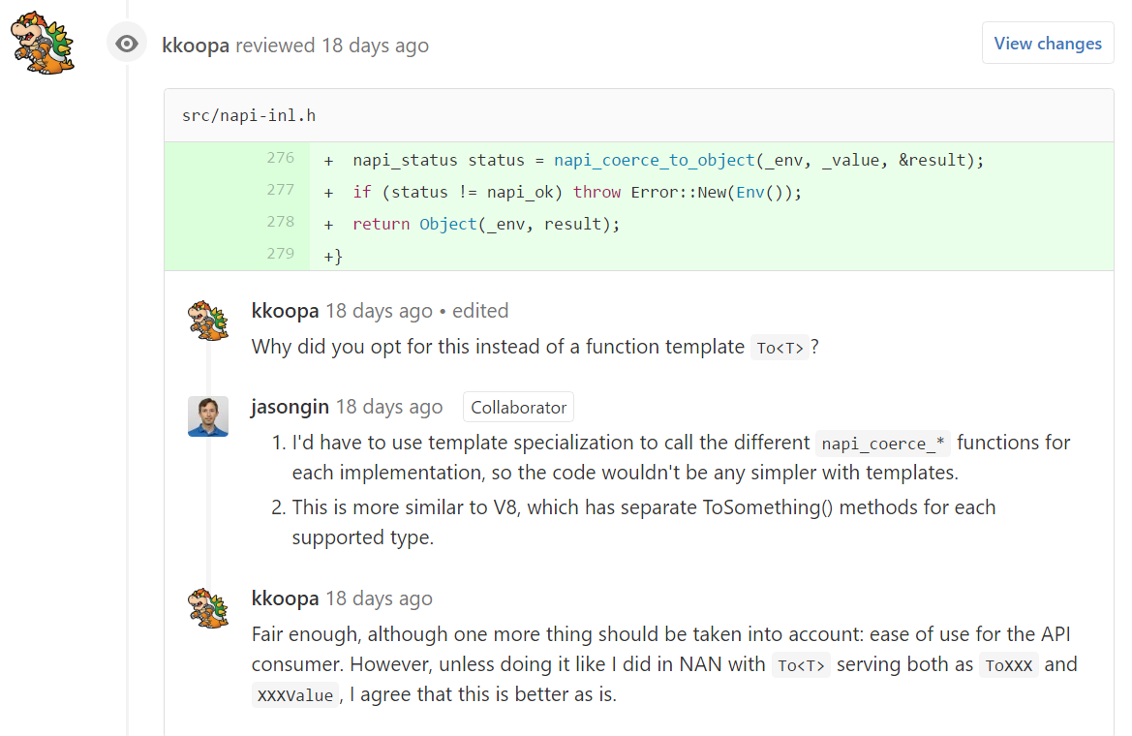

Core Team and community participation
Core Team

Slide 5
Progress Update
N-API support now available for the following Node versions
8.x Master
6.x LTS
Node-ChakraCore
Reviewed by V8 and ChakraCore Teams
Modules Converted
Node-Sass
Canvas
Leveldown
Nanomsg
IoTivity (~90% complete)

Slide 6
Progress Update contd …
API Shape & Error Handling
NODE_EXTERN napi_status napi_get_value_string_length(napi_env e, napi_value v, int* result);
NODE_EXTERN const napi_extended_error_info* napi_get_last_error_info();
NODE_EXTERN napi_status napi_is_exception_pending(napi_env e, bool* result);
NODE_EXTERN napi_status napi_get_and_clear_last_exception(napi_env e, napi_value* result);
NODE_EXTERN napi_status napi_throw(napi_env e, napi_value error);
API usability
Flat C-style APIs
Optional C++ wrapper add-on
Notes:
Only when napi_status is non-zero

Slide 7
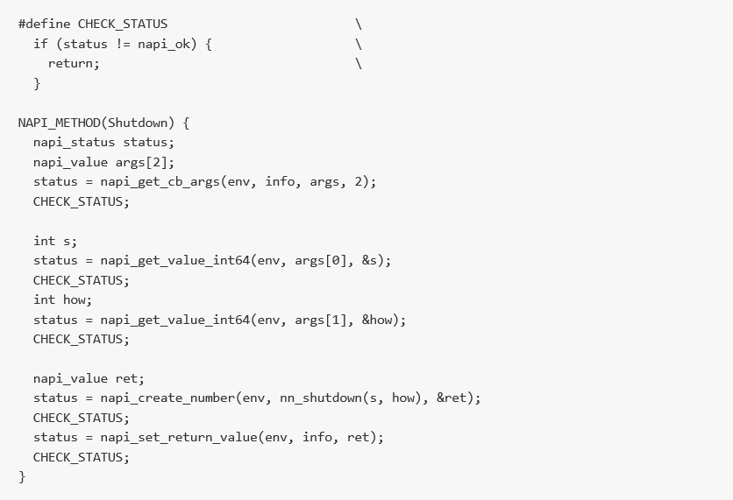
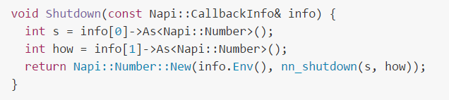
API Usability
Flat C-style API
C++ wrapper has built in Error Handling.
The wrapper may throw C++ exceptions, that are automatically re-thrown as JavaScript exceptions if not handled.
C++ Wrapper

Slide 8
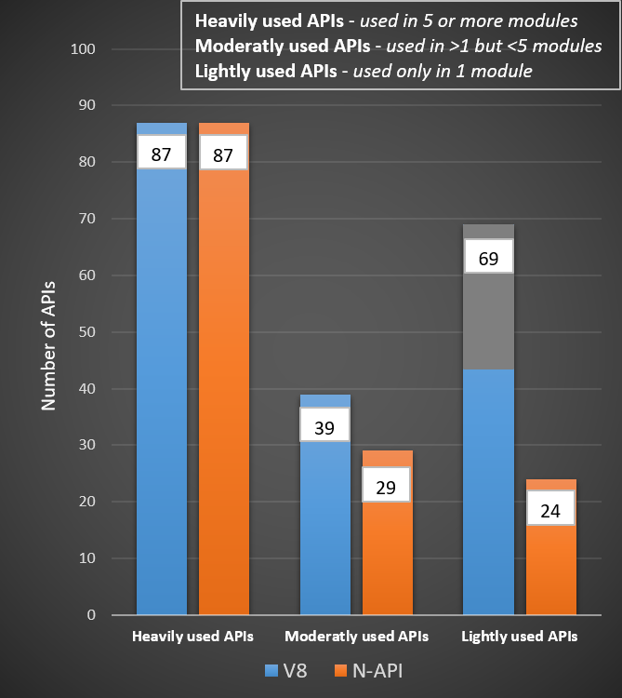
N-API Coverage*
195 V8 APIs used
140/195 N-API equivalent exists
83/195 Exercised by 5 ported modules
* Data based on Top 30 depended on native modules

Slide 9
V8 APIs with no N-API Equivalent
v8::Context::Enter
v8::Context::Exit
v8::FunctionTemplate::Inherit
v8::Locker::~Locker
v8::Locker::Initialize
v8::Private::ForApi
v8::String::Concat
v8::String::NewFromOneByte
v8::TryCatch::StackTrace
v8::UnboundScript::GetId (Issue #51)
v8::Unlocker::~Unlocker
v8::Unlocker::Initialize
v8::V8::FromJustIsNothing
v8::Value::IsBooleanObject
v8::Value::IsDate
v8::Value::IsNativeError
v8::Value::IsNumberObject
v8::Value::IsRegExp
v8::Value::IsStringObject
v8::Value::ToDetailString
v8::Script::Compile (Issue #51)
v8::Script::GetUnboundScript (Issue #51)
v8::ScriptCompiler::ExternalSourceStream::ResetToBookmark
v8::ScriptCompiler::ExternalSourceStream::SetBookmark
v8::Isolate::AddGCEpilogueCallback
v8::Isolate::AddMemoryAllocationCallback
v8::Isolate::AddMessageListener
v8::Isolate::CancelTerminateExecution
v8::Isolate::CollectAllGarbage
v8::Isolate::DiscardThreadSpecificMetadata
v8::Isolate::Enter
v8::Isolate::Exit
v8::Isolate::IsDead
v8::Isolate::IsExecutionTerminating
v8::Isolate::RemoveGCEpilogueCallback
v8::Isolate::RemoveGCPrologueCallback
v8::Isolate::RemoveMemoryAllocationCallback
v8::Isolate::RemoveMessageListeners
v8::Isolate::SetAllowCodeGenerationFromStringsCallback
v8::Isolate::SetCaptureStackTraceForUncaughtExceptions
v8::Isolate::SetFailedAccessCheckCallbackFunction
v8::Isolate::SetFatalErrorHandler
v8::Isolate::SetStackLimit
v8::Isolate::TerminateExecution
v8::Isolate::VisitExternalResources
v8::Isolate::VisitHandlesForPartialDependence
v8::Isolate::VisitHandlesWithClassIds
v8::Object::Delete (Issue #94)
v8::Object::GetIsolate
v8::Object::GetOwnPropertyNames (Issue #67)
v8::Object::GetPrivate
v8::Object::HasPrivate
v8::Object::SetPrivate
v8::ObjectTemplate::SetHandler

Slide 10
Demo
https://github.com/boingoing/napi_demo

Slide 11
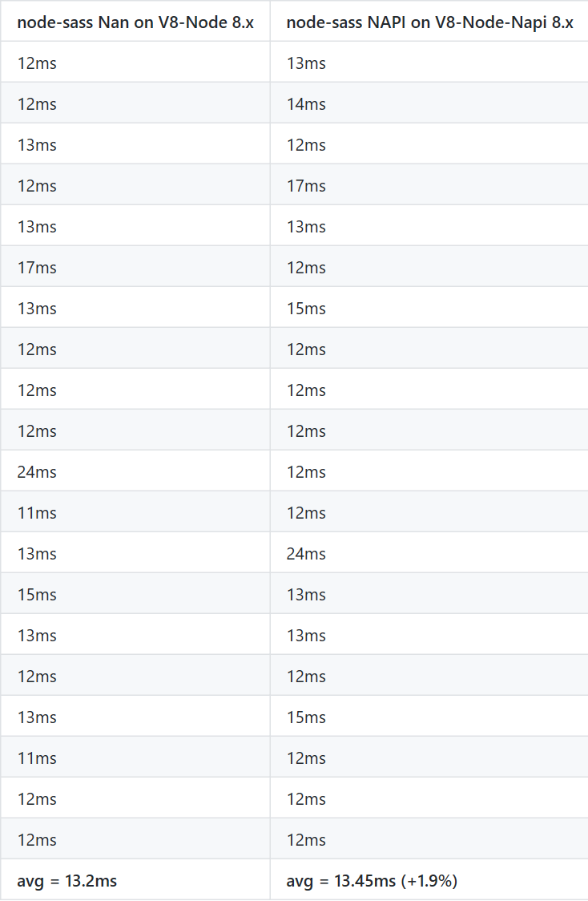
Perf Node-Sass
Ported using C style API
N-API adds 1.9% perf delta
System Info:
Windows 10 x64
Intel Xeon E5-1620 v3 @ 3.50GHz
16GB DDR4 @ 2133MHz
Samsung XP941 SSD
Details at: https://github.com/nodejs/abi-stable-node/issues/82

Slide 12
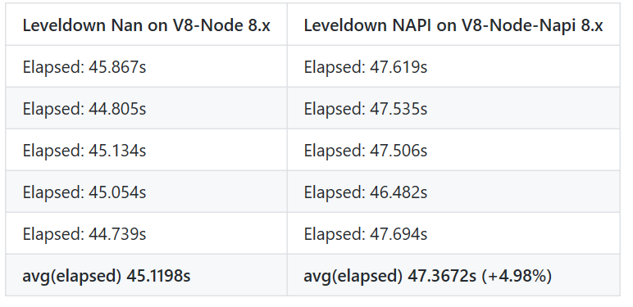
Perf Leveldown
Ported using C style API
Benchmark includes 1M entries DB Size 110 MB
N-API adds 5% perf delta
System Info:
Windows 10 x64
Intel Xeon E5-1620 v3 @ 3.50GHz
16GB DDR4 @ 2133MHz
Samsung XP941 SSD
Details at: https://github.com/nodejs/abi-stable-node/issues/55

Slide 13
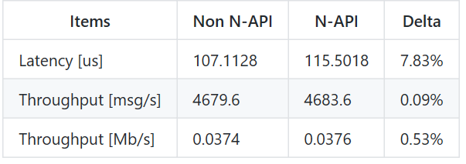
Perf Nanomsg
Ported using C style API
Workload size 1 byte message
Performance within expected range
System Info:
Ubuntu 14.04.2 LTS (GNU/Linux 3.13.0-55-generic x86_64)
Intel CPU @ 2400 MHz
Details at: https://github.com/nodejs/abi-stable-node/issues/57

Slide 14
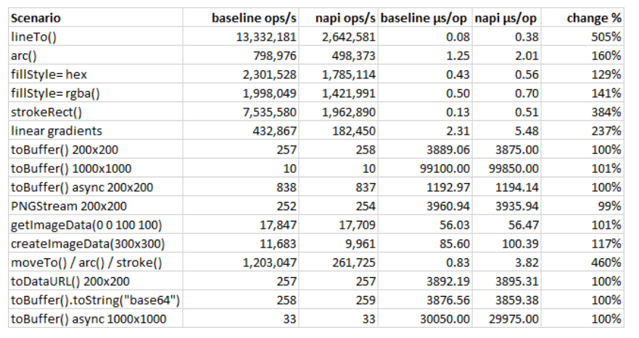
Perf Canvas
Ported using C++ wrapper
Perf regression in chatty benchmarks
System Info:
Windows 10 x64
Intel Xeon W3530 @2.8GHz, 20 GB RAM
Details at: https://github.com/nodejs/abi-stable-node/issues/77

Slide 15
Thoughts on Performance so far…
No performance tuning done yet!
Expected performance for broad use cases to be within 0-10%
Extremely chatty operations with native module see a larger perf regression

Slide 16
Work Items Remaining
Performance fine tuning
Increase API Coverage
Test coverage
CI Integration
N-API version management
Documentation and Support
Auto conversion tool from NAN to N-API
Notes:
Major changes are behind us

Slide 17
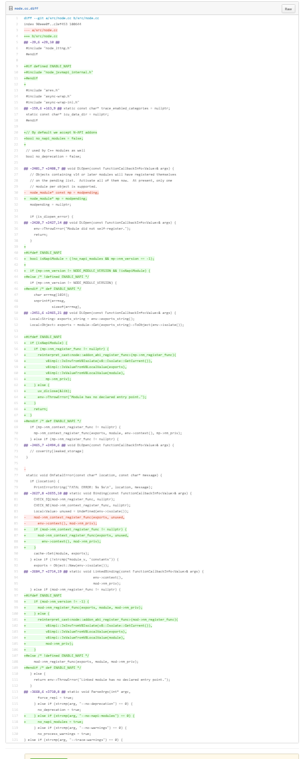
Proposal: N-API Compiled in by default in Node v8.0
We recommend to have N-API compiled in by default without build flags, for ease of use to allow broader usage. Gating can be done via command-line option if needed.
Node.cc changes for N-API are non-intrusive. It gets triggered only for N-API modules.
https://gist.github.com/gabrielschulhof/763a8563deab4eb5f681df3817658fe0

Slide 18
Discussion: API Evolution
Option #1: Forward Compatibility
Modules compiled with older versions continue to work in newer versions
Modules dependent on newer APIs in new Node versions cannot work on older versions
Considerations:
Conditional source compilation
Backporting of API Stubs
Option #2: Backward Compatibility
Modules can take advantage of newer APIs in new Node versions and can fallback to supporting older APIs without distributing multiple versions of the module.
Considerations:
Runtime API version checking
Extra level of indirection (perf impact unclear)

Slide 19
Key next steps
Submit PRs for the following
Node version 8.0
Node version 6.9 LTS
Node-ChakraCore (after N-API lands in node master)
Documentation
Continue working on module ports to increase API coverage for Top 30 modules
Evangelize and engage with native module developers to identify gaps

